Slide 1
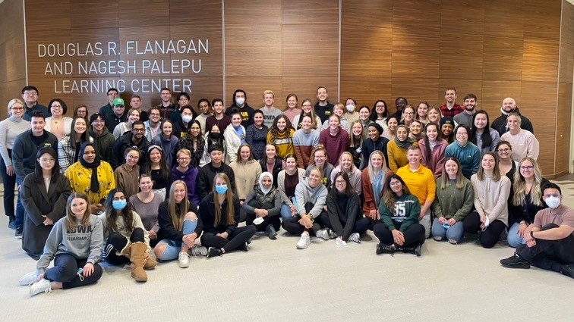
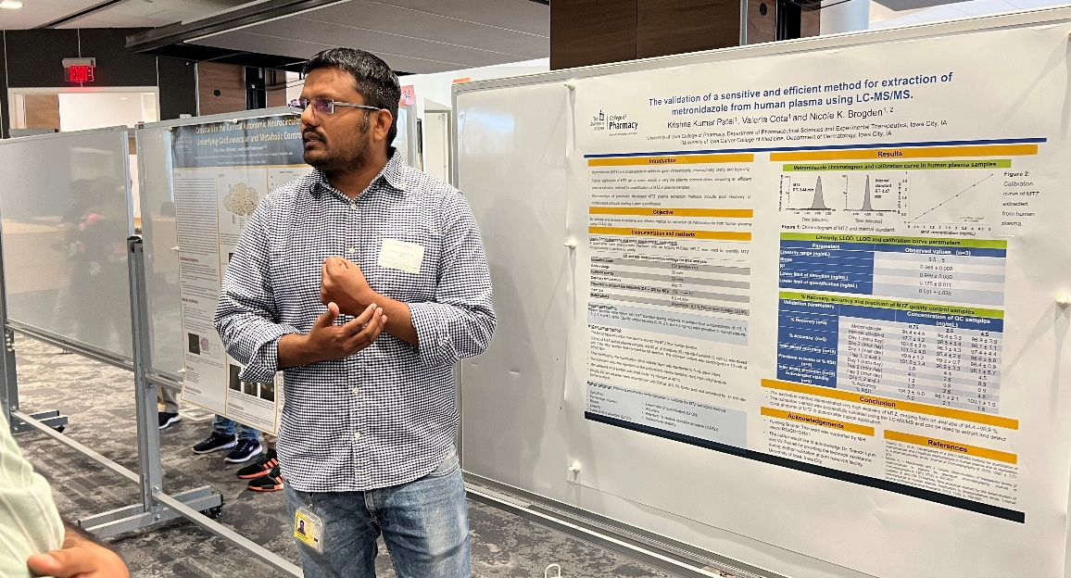

What Makes us Great

Slide 2
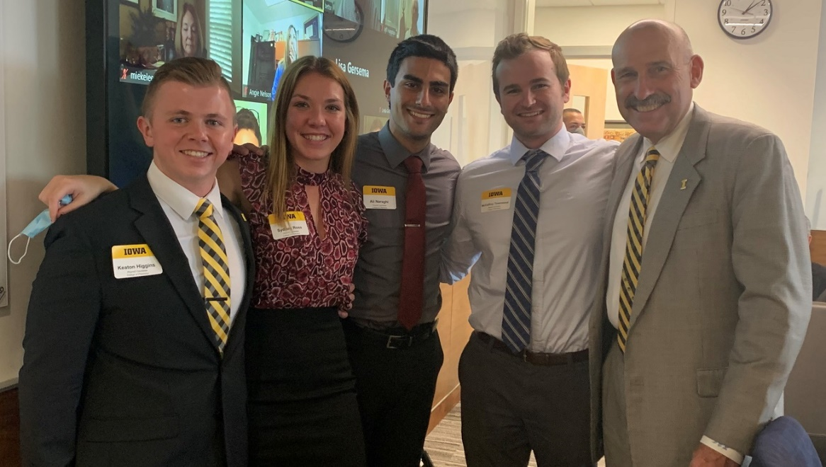
Leadership Development
  18 Student Organizations
  Pharmacy Leadership Certificate
  Hart Entrepreneurial Program
  Active Mentorship Programs
  Interprofessional Activities

Slide 3
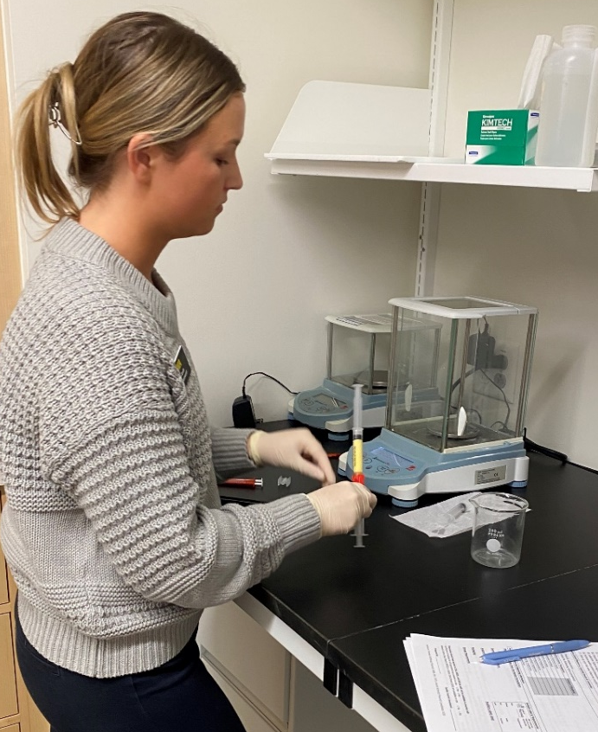
Excellence in Education
  State-of-the-Art Practice Learning Center
  Emphasizing Clinical Practice Skills
  Career Specialization
  Graduate Program -- 99% Placement Rate
  Consistently High Residency Match Rate
  Academic Health Center (UIHC) with
  Direct Patient Care Experience (steps away from College)

Slide 4
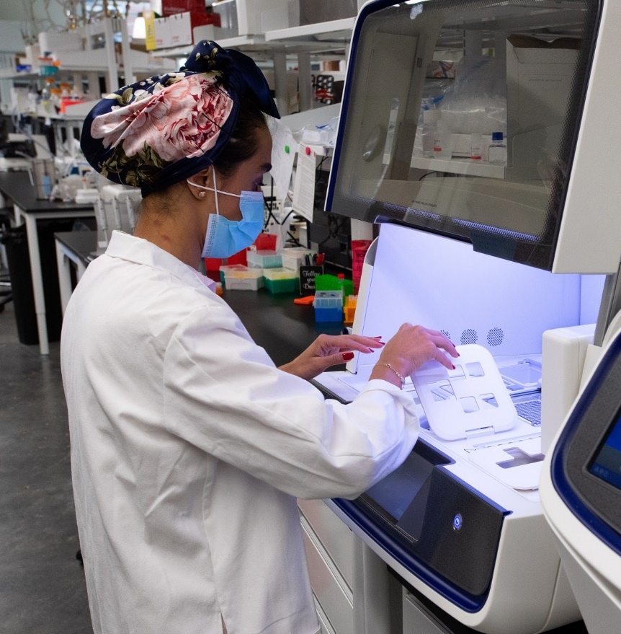
Research Institution
  Drug Discovery, Drug Development,
  Health Care Delivery
  Research Grants and Contracts
  Grew 17% in 2021-2022
  Partners with Premiere
  Health Care Campus
  Millions of Dollars in Grants Annually

Slide 5
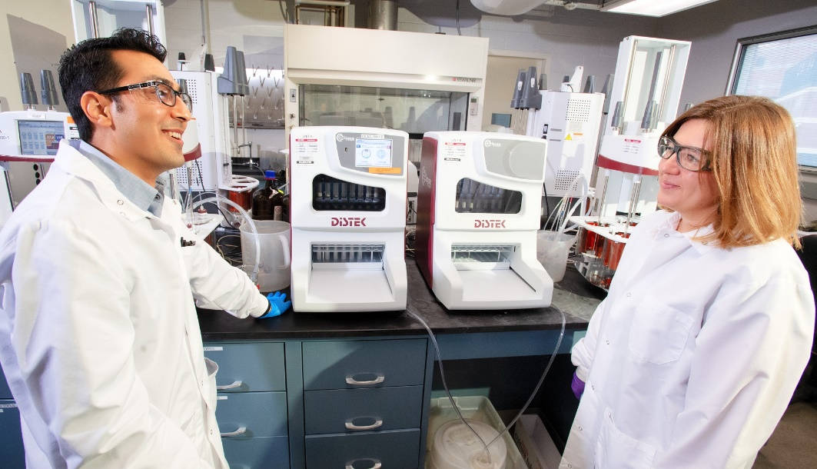
UI Pharmaceuticals
  FDA-Registered, University-Affiliated
  Drug Development and
  Manufacturing Organization
  Industry Partner with Biotech,
  Government, and Universities
  Longest Running CDMO in the U.S.
  (associated with a University)

Slide 6

Supportive Culture
  Differences are Celebrated
  Students are Valued
  Engaged Faculty
  Fosters the Importance of Community

Slide 7
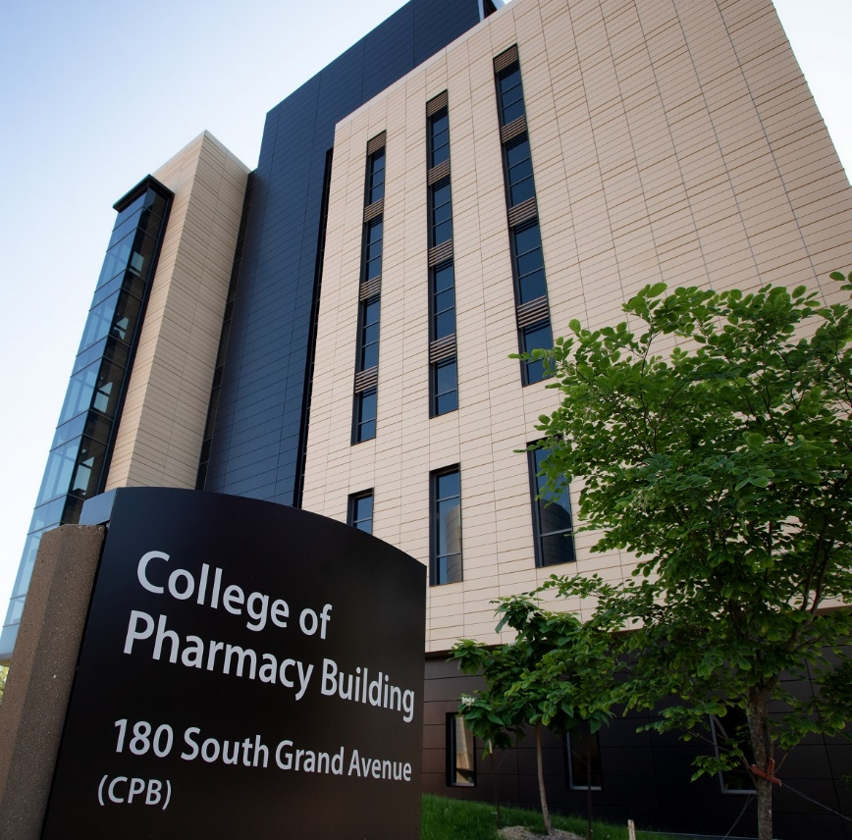
About our State-of-the-Art Building
Inclusivity Focused – Elements of Universal Design (beyond ADA requirements) can be found throughout the building, including
built-in hearing loops, height-adjusted work surfaces and podiums, color-coded wayfinding, and evacuation chairs.
Community Focused – Space for students to gather, collaborate,
and study together (PODS, team rooms, lobby area).
Learning Spaces – Featuring 23 active learning centers and
collaborative spaces.
Flexible Classrooms – Conducive to student-led learning.
Graduate Student Space – To collaborate outside their research
labs, including dedicated office space and team rooms.
Total Size - 228,000 sq. ft.

